Slide 1

SQL Server 2022

Slide 2








Reactive
Customer never disrupted
Production line down
Proactive maintenance visit
Service center operator logs issue
Anomaly detection model
Emergency service visit
Customer disruption resolved

Slide 3
Proactive
Data Ingested
Anomaly detection model
Service center operator logs issue
Proactive maintenance visit
Customer never disrupted

Slide 4

Today’s data realities
02-01.01
3
What data do I have?
Data governance
Is it trustworthy?
2
Can people access the data needed to make the right decisions?
Analytics
1
How can I enable faster business insights?
Operational databases
What’s my compliance exposure?
Notes:
…And doing this isn’t easy, given the realities of data today. The volume, variety and velocity of data are all accelerating dramatically, and the complexity of creating of an enterprise ‘knowledge graph’ can seem insurmountable. Today we generate data far faster than we are able to understand it
In fact, IDC predicts that by 2025, just 5 years from now, the world’s data will climb to 175 zettabytes. To put that in perspective, if you were to store that data in a stack of BluRay discs you’d be able to go to the moon and back 23 times!
Without the right people, processes and capabilities in place, it can be difficult to answer fundamental questions like:
What data do I have?
Is it trustworthy?
Are people getting the data they need to make the right decisions?
Are they getting it fast enough?
And are we managing data in a compliant way?...

Slide 5

Introducing Microsoft Intelligent Data Platform
3
Data governance
2
Analytics
1
Operational databases
Microsoft Intelligent Data Platform
SQL Server • Azure SQL • Azure Cosmos DB • Azure Synapse Analytics
Azure Databricks • Power BI • Microsoft Purview • Azure AI
Operational databases | Analytics | Data governance
Notes:
Getting the right answers to these questions is possible when all your data assets are connected and managed in a cohesive fashion. This is why we announced the Microsoft Intelligent Data Platform, the leading cloud data platform that empowers organizations to invest more time creating value rather than integrating and managing their data estate.
The platform is made up of capabilities across databases, analytics and governance that, on their own, meet specific business needs and already bring many benefits but together helps easily evolve applications to include advanced analytics and intelligence. It is the integration of the products you are already using today to accelerate innovation and achieve agility, across our cloud, as well as others
We want to remove key points of friction between your databases and analytics systems while ensuring your full data estate can be automatically mapped and governed
Organizations can analyze large volumes of operational data in near real-time with no extraction, transformation, or loading (ETL) pipelines, and no performance impact on transactional workloads
And anyone in the organization, whether they’re a data scientist, data analyst or a domain expert, can access, analyze, and share data
This is the state we are all aiming for is where we can:
Accelerate innovation, Focus on what matters most – your business. Free resources to create frictionless customer experiences, transform products and empower employees.
Achieve agility, Pivot faster to respond to dynamic environments with an integrated data platform that adapts to your needs with hybrid and multi cloud capabilities. Build how you want, deploy where you want and gain fast, continuous insights.
Build on a trusted platform, Deliver data-powered experiences with the security and privacy controls required to innovate with confidence. Azure provides the most comprehensive protection for your valuable business data.

Slide 6
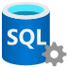
SQL Server investments over the years
Continual innovations built into SQL Server, giving you higher return on your investments
SQL Server 2019
Intelligent Database performance, security, and management enhancements
SQL Server 2017
Available on any platform — Linux or Windows
AI built-in with support for R and Python
SQL Server 2016
Everything built-in — Mission critical performance and availability
Always Encrypted security

Slide 7






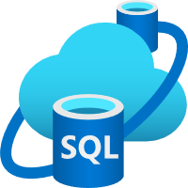


SQL Server 2022 Azure-enabled with continued performance and security innovation
Business continuity through Azure
Seamless analytics over on-prem operational data
Visibility over your entire data estate
Most secure over the last 10 years¹
Industry-leading performance and availability
Microsoft Purview
+
Data Insights
Data Catalog
#1 OLTP performance²
#1 Non-Clustered DW performance on 1TB³, 3TB⁴, 10TB⁵, 30TB⁶, and 100TB⁷
Data Map
Hero capabilities
Bidirectional DR to Azure SQL
Azure Synapse Link
Microsoft Purview integration
SQL Server ledger
Built-in query intelligence
Multi-write replication
Most consistent data platform
Edge to Cloud
Azure SQL Edge
Azure Arc-enabled data services
Azure SQL
Bidirectional disaster recovery is available in limited public preview. General availability will occur at a future date.
TPC Claims as 11/2022
¹National Institute of Standards and Technology Comprehensive Vulnerability Database ² http://www.tpc.org/4087; ³ www.tpc.org/3386; ⁴ http://www.tpc.org/3385; ⁵ https://tpc.org/3383; ⁶ http://www.tpc.org/3364; ⁷ https://tpc.org/3382;

Slide 8
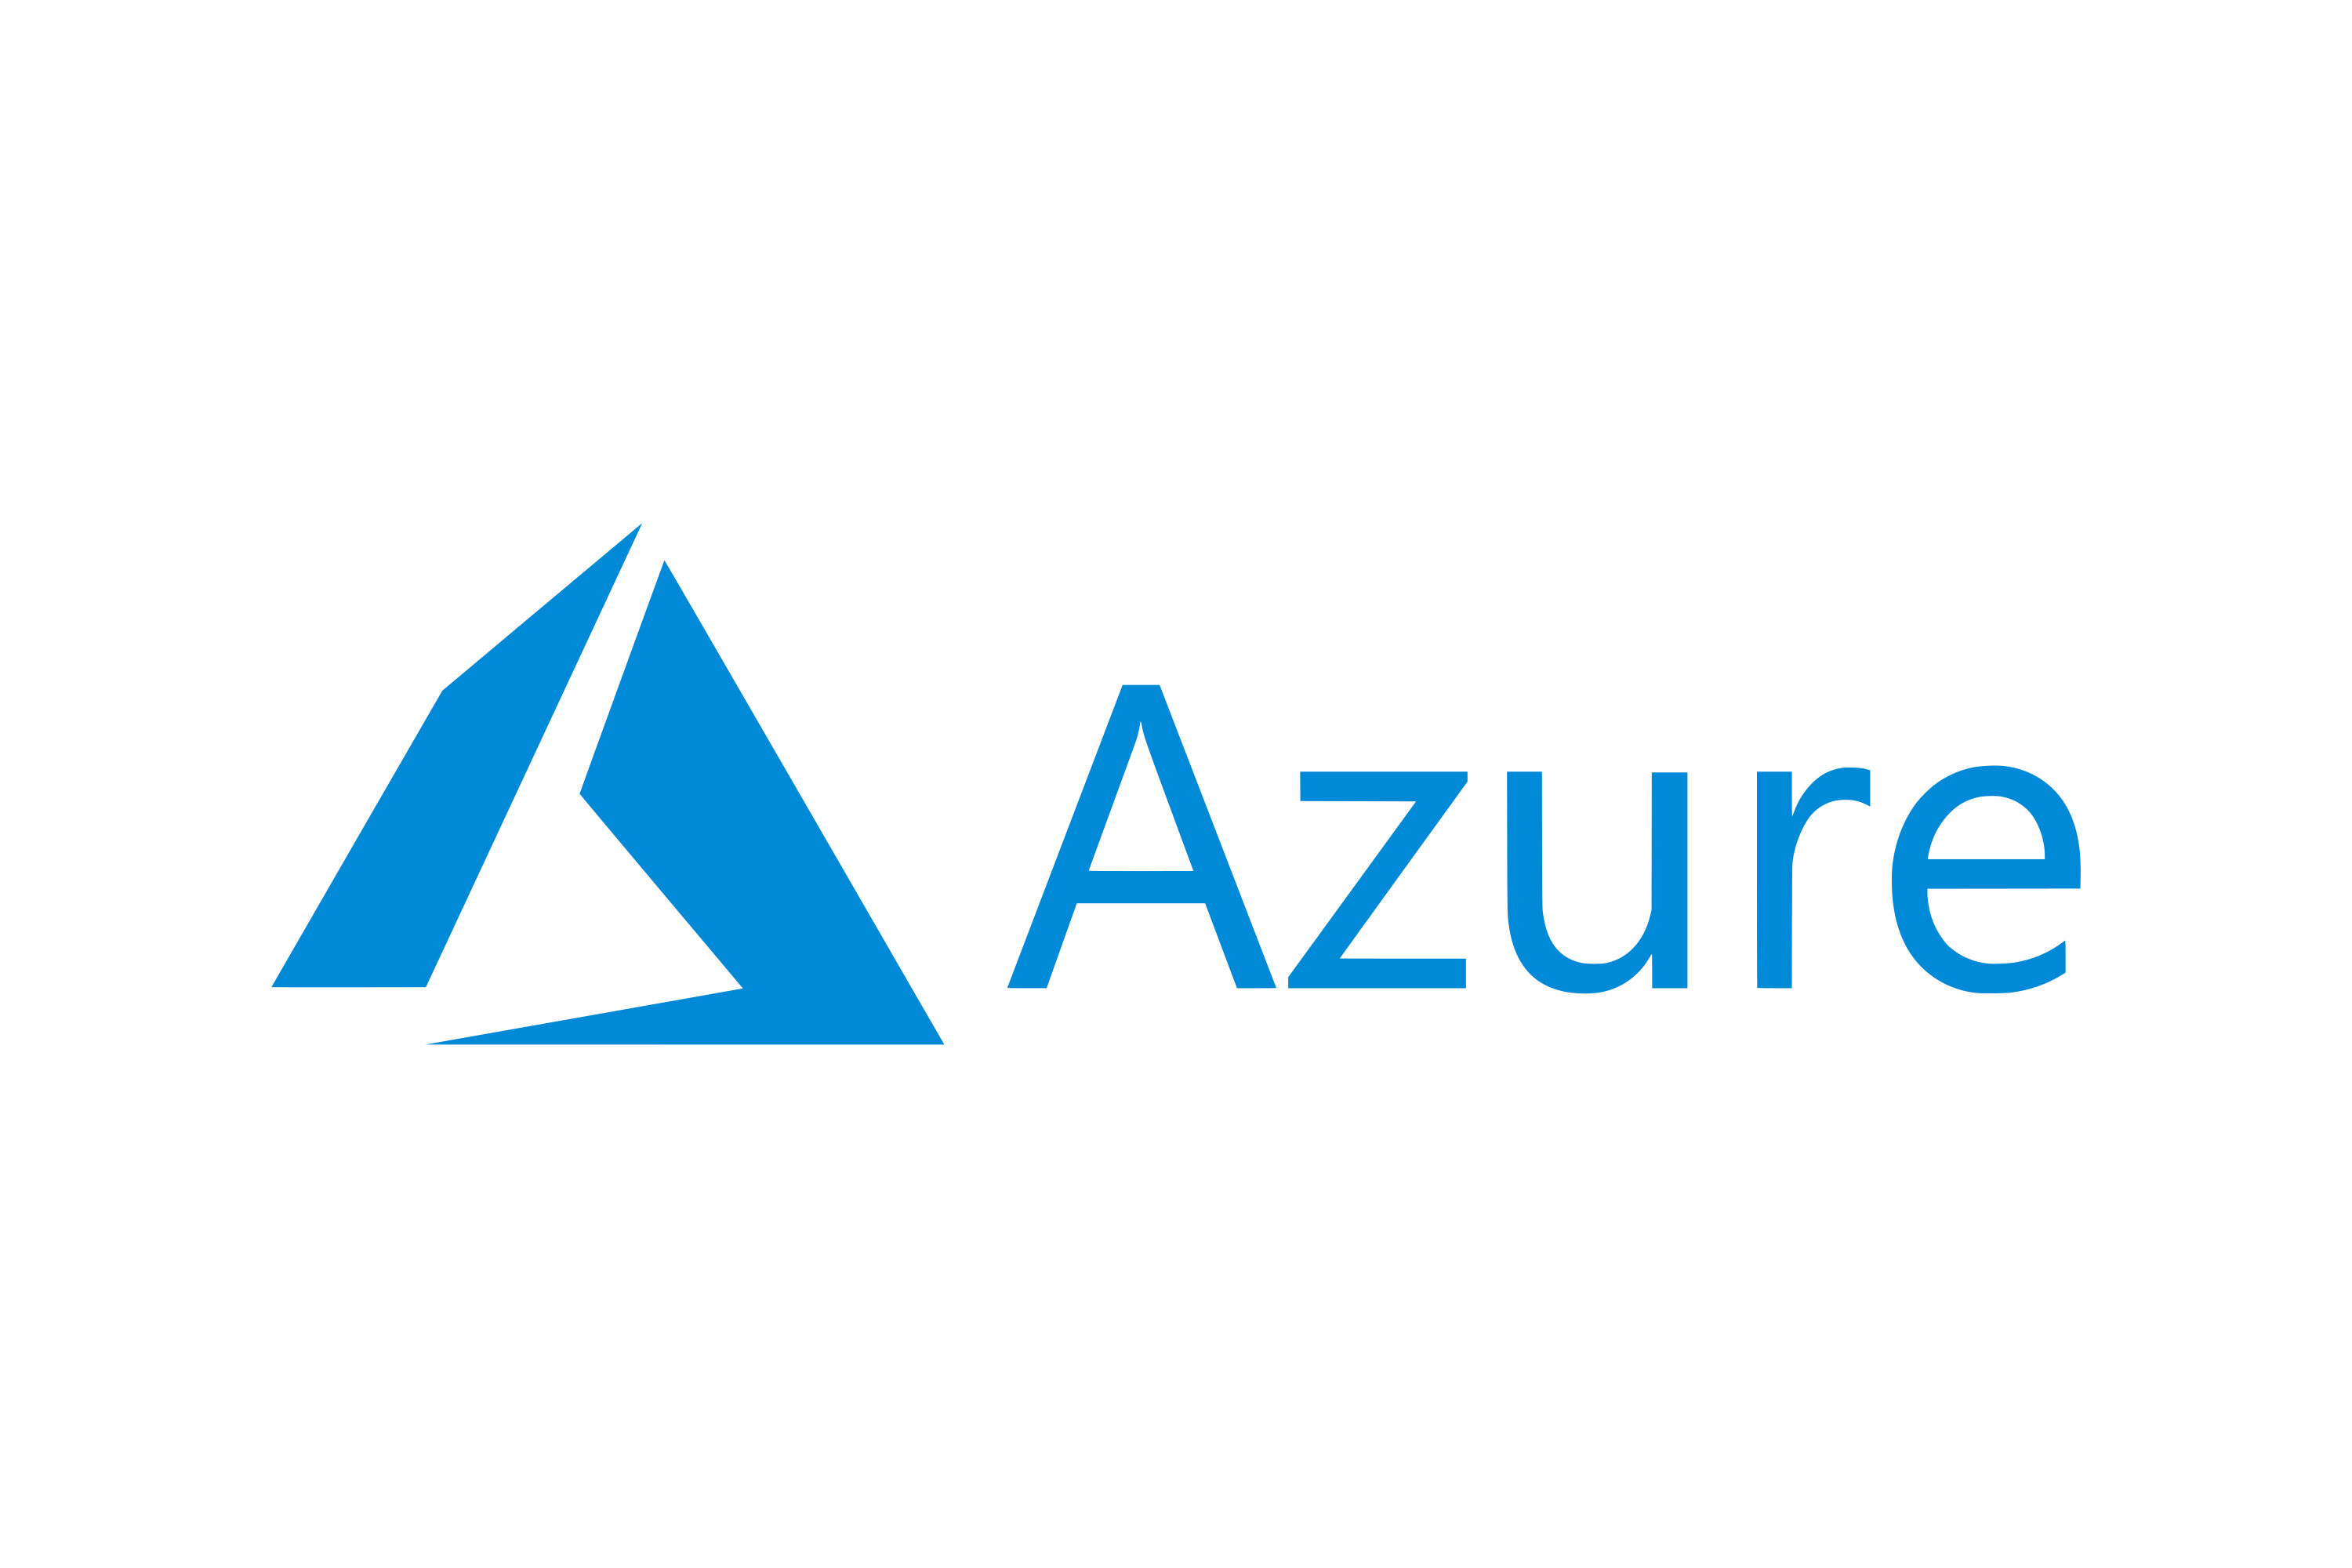
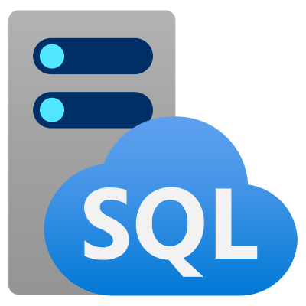
SQL Server 2022 — Business continuity through Azure Increase uptime
Challenge
Setting up disaster recovery in an IaaS environment creates management overhead
Continuously replicate data to and from the cloud
Solution
Run disaster recovery with less maintenance with new link feature for Azure SQL Managed Instance
Online failover
Azure
Deploy and configure easily with PaaS
Optionally use Azure SQL Managed Instance for read-scale out
Built-in distributed availability group (DAG)
Restore Azure SQL Managed Instance databases back to SQL Server
DR in the cloud
SQL Server 2022
Azure SQL Managed Instance

Slide 9


SQL Server 2022 — Seamless analytics over on-prem operational data Real-time insights
Challenge
Using ETL to move data from on-premises is challenging, expensive and creates insight lags
Store2
Power BI
Solution
Azure Synapse Link for SQL Server 2022 provides automatic change feeds that capture the changes within SQL Server
12
123
Cloud data
IoT data
SaaS data
Azure Synapse Analytics
Azure Machine Learning
Break the wall between operational and analytical stores
New change feed capability reduces impact on OLTP workloads
Near real-time latency between SQL Server and Synapse Analytics
Analyze all your data using both Spark and SQL runtimes in Synapse
Store
Store
SQL pools
Azure Data Lake Storage
Spark pools
On-premises

Slide 10
SQL Server 2022 — Visibility over your entire data estate Break down data silos
Challenge
Having multiple data sources create fragmented visibility of data estates
Solution
Azure Purview integration with SQL Server 2022 enables visibility over your entire data estate
Data Map
Automatically scan on-prem SQL Server to capture metadata across multiple SQL deployments edge to cloud
Classify data using built-in and custom classifiers and Microsoft Information Protection sensitivity labels
Set up and control specific access rights to SQL Server
Data Catalog
Data Insights

Slide 11





Industry-proven database engine Security, scalability, and availability
Secure
Scalable
Available
SQL Server ledger
Always encrypted enhancements
Linux security enhancements
Buffer pool parallel scan
System page latch concurrency enhancements
In-memory OLTP memory enhancements
Multi-write replication with last writer wins
Cross-platform SNAPSHOT backups
Intel QuickAssistTM backup compression

Slide 12

SQL Server 2022 — Most secure over the last 10 years Tamper-proof track record of data over time
Challenge
Difficult to establish trust for integrity of data stored in database systems for sensitive data
Bank Regulator
Bank A
Solution
Track any potential data changes from malicious actors with ledger feature in SQL Server 2022
Ledger view
Use a cryptographically hashed ledger to detect tampering and by malicious actors
Establish digital trust in a centralized system using blockchain technology
Attest to other parties that data integrity has not been compromised
Append-only ledger table
Updatable ledger table
History table
Block N
Block N-1
Block N-2
Trusted storage
Database ledger

Slide 13
SQL Server 2022 — Industry-leading performance and availability Accelerate query performance with no code changes
Challenge
DBAs spend most of their time tuning database performance, leading to high operational costs
Intelligent Query Processing (IQP)
Next Generation
Solution
New Intelligent Query Processing and Query Store capabilities accelerate performance with no code changes
Query Store now turned on by default
Query hints to shape plans with no code changes
Support for read replicas from availability groups
New IQP scenarios enabled through better together capabilities
Query Store

Slide 14
SQL Server 2022 — Industry-leading performance and availability Accelerate query performance with no code changes
Challenge
DBAs spend most of their time tuning database performance, leading to high operational costs
Intelligent Query Processing (IQP)
Next Generation
Solution
New Intelligent Query Processing and Query Store capabilities accelerate performance with no code changes
Max Degree of Parallelism (DOP) feedback
Cardinality Estimation (CE) feedback
Parameter Sensitive Plan (PSP) Optimization
Query Store now turned on by default
Support for read replicas from availability groups
New IQP scenarios enabled through better together capabilities
“On” by default
Query Store

Slide 15
SQL Server 2022 — Industry-leading performance and availability Multi-master writes for users across multiple locations
Challenge
Users in different locations can run into replication conflicts
T1: Update row 1 set A = 23
T0: Update row 1 set A = 45
Solution
Multiple writeable copies of the same database with eventual consistency
Replica 1
Replica 2
Globally distributed database replicas for geo-localized writes
Enhanced conflict detection for inserts and updates with Last Writer Wins (LWW) capabilities
Ensures the last update is persisted across all replicas based on the UTC time of the operation
Final Value?
A = 45 without LWW (highest replica wins regardless of timing)
A= 23 with LWW (last update wins regardless of replica ID)

Slide 16




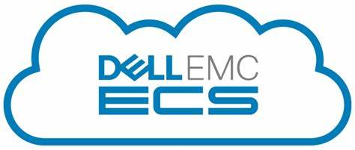
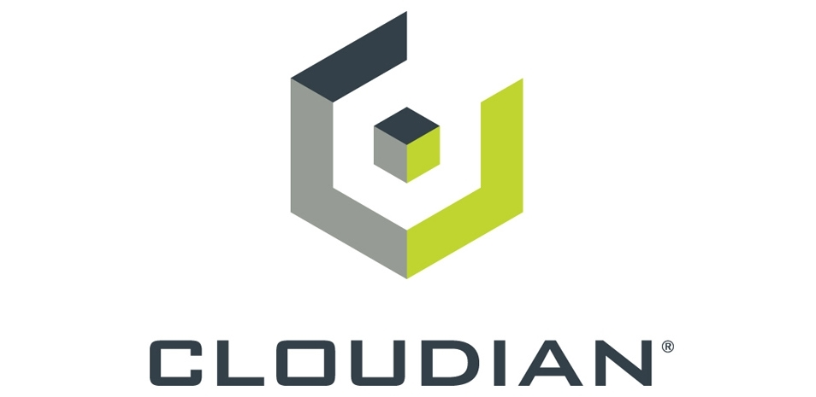



Data lake virtualization and object storage Query any data lake and backup/restore SQL to object storage
Challenge
I need to access and use other storage systems
disk
URL
Solution
Work with data outside of SQL Server using native T-SQL
Backup/restore SQL to REST API compatible object storage
PolyBase (REST API)
Query data where it resides with data virtualization
Support for REST API and new native types like Parquet, json, and Delta
REST API compatible object storage for backup and restore
T-SQL
OPENROWSET or EXTERNAL TABLE
Formats
Parquet, json, csv
Delta
Connectors
s3, ADLS Gen2, Azure Blob Storage

Slide 17


Language enhancements for developers Use your T-SQL skills to do more than ever
Challenge
I do not want to learn new languages to access new features
Solution
Increased support for JSON, T-SQL, and Time Series
New JSON functions to increase ability to query and manipulate JSON data
Enhanced T-SQL Surface Area closes language gaps based on customer feedback and ANSI compatibility
Brings Azure SQL Edge support for T-SQL functions to process time series data (telemetry at intervals)

Slide 18
Thank you
Learn more about SQL Server 2022
aka.ms/sqlserver2022
Download SQL Server 2022
aka.ms/sql22download
Watch a technical deep-dive on SQL Server 2022
aka.ms/sqlserver2022mechanics
Watch the Data Exposed series
aka.ms/dataexposed-sqlserver2022

Slide 19
Appendix

Slide 20
SQL Server 2022 continues to deliver unparalleled value
2016 additions
2017 additions
2019 additions
2022 additions
JSON Support
PolyBase
Basic High Availability
Row Level Security
Enhanced Separation of Duties
Dynamic Data Masking
Single-threaded Microsoft R Server
Connectivity to R Open
Basic tabular (16GB memory per instance)
Modernized reports
Pin report to Power BI
Enhanced multi-dimensional models
Simplified Backup to Microsoft Azure
Stretch Database
Support for Linux including Red Hat Enterprise Linux (RHEL), SUSE Linux Enterprise Server (SLES), and Ubuntu
Support for Docker containers on Linux and Windows
Python language support
Support for graph data
Automatic plan correction and adaptive query processing
Cross platform availability groups
Power BI reporting both on-premises and in the cloud
Access to Power BI Report Server
Graph data support
Object-level security
Big Data clusters with Apache Spark and HDFS
Data virtualization to integrate external data sources
Azure Machine Learning and Spark ML
Support for Kubernetes deployment
Free supported Java
Native UTF-8 support
In-Memory Database: Persistent Memory support
Accelerated database recovery
Free DR to Azure
Always Encrypted with secure enclaves
Data classification & auditing
Vulnerability assessment
Notebook support for T-SQL, Python, R, and Scala in Azure Data Studio
Link feature in Azure SQL Managed Instance
Synapse link for SQL Server
Azure Purview policies
SQL Server Ledger
Large memory and concurrency scalability
Multi-write replication
Data virtualization for any data lake
Object storage backup and restore
Query Store on by default with replica support
Query Store hints
Intelligent Query Processing NextGen
JSON data
Modern T-SQL surface area
Time series support

Slide 21
Thank you

Slide 22
Business continuity through Azure SQL Managed Instance Disaster recovery in the cloud with link feature in Azure SQL Managed Instance
Deploy and configure easily with PaaS
Optionally use Azure SQL Managed Instance for read-scale out
Built-in distributed availability group (DAG)
Restore Azure SQL Managed Instance databases back to SQL Server
Continuously replicate data to and from the cloud
Online failover
Azure
DR in the cloud
SQL Server 2022
Azure SQL Managed Instance

Slide 23

Azure Synapse Link for SQL Server Seamless analytics over on-prem operational data
Store2
Break the wall between operational and analytical stores
New change feed capability reduces impact on OLTP workloads
Near real-time latency between SQL Server and Synapse Analytics
Analyze all your data using both Spark and SQL runtimes in Synapse
Power BI
12
123
Cloud data
IoT data
SaaS data
Azure Synapse Analytics
Azure Machine Learning
Store
Store
ETL
SQL pools
Azure Data Lake Storage
Spark pools
On-premises

Slide 24
Azure Purview integration Visibility and governance over your entire data estate
Automatically scan on-prem SQL Server to capture metadata
Classify data using built-in and custom classifiers and Microsoft Information Protection sensitivity labels
Set up and control specific access rights to SQL Server
Data Catalog
Data Map
Data Insights

Slide 25
SQL Server ledger Tamper-proof track record of data over time
Bank Regulator
Bank A
Use an immutable ledger to protect data from tampering and by malicious actors
Establish digital trust in a centralized system using blockchain technology
Attest to other parties that data integrity has not been compromised
Ledger view
Append-only ledger table
Updatable ledger table
History table
Block N
Block N-1
Block N-2
Trusted storage
Database ledger

Slide 26
Industry-proven database engine Security, scalability, and availability
Secure
Scalable
Available
SQL Server ledger
Always encrypted enhancements
Linux security enhancements
Buffer pool parallel scan
System page latch concurrency enhancements
In-memory OLTP memory enhancements
Multi-write replication with last writer wins
Cross-platform SNAPSHOT backups
Intel QuickAssistTM backup compression

Slide 27
Multi-write replication Multi-master writes for users across multiple locations
Globally distributed database replicas for geo-localized writes
Enhanced conflict detection for inserts and updates with Last Writer Wins (LWW) capabilities
Ensures the last update is persisted across all replicas based on the UTC time of the operation
T1: Update row 1 set A = 23
T0: Update row 1 set A = 45
Replica 1
Replica 2
Final Value?
A = 45 without LWW (highest replica wins regardless of timing)
A= 23 with LWW (last update wins regardless of replica ID)

Slide 28
Query Store and Intelligent Query Processing Accelerate query performance and tuning with no code changes
Query Store now turned on by default
Query Store support for read replicas from availability groups
New IQP scenarios enabled through better together capabilities
Intelligent Query Processing (IQP)
Next Generation
Query Store

Slide 29
Query Store and Intelligent Query Processing continued Accelerate query performance and tuning with no code changes
Query Store now turned on by default
Query Store support for read replicas from availability groups
New IQP scenarios enabled through better together capabilities
Intelligent Query Processing (IQP)
Next Generation
Max Degree of Parallelism (DOP) feedback
Cardinality Estimation (CE) feedback
Parameter Sensitive Plan (PSP) Optimization
“On” by default
Query Store

Slide 30

Data lake virtualization and object storage Query any data lake and backup/restore SQL to object storage
disk
URL
Backup/restore SQL to s3 compatible storage
PolyBase (REST API)
T-SQL
OPENROWSET or EXTERNAL TABLE
Formats
Parquet, json, csv
Delta
Connectors
s3, ADLS Gen2, Azure Blob Storage

Slide 31
Language enhancements for developers Use your T-SQL skills to do more than ever
JSON data
New JSON functions to increase ability to query and manipulate JSON data
Enhanced T-SQL Surface Area
Closing language gaps based on customer feedback and ANSI compatibility
Time Series
Bring Azure SQL Edge support for T-SQL functions to process time series data (telemetry at intervals)

Slide 32


SQL Server 2019
Industry-leading performance and security, with intelligence over all your data
Intelligence over any data
Choice of platform, language and container
Industry-leading performance and availability
Most secure over the last 9 years⁵
Insights in minutes on any device
+
#1 OLTP performance¹
#1 DW performance on 1TB², 10TB³, and 30TB⁴
Intelligent Query Processing
PHP
Node.js
C#/VB.NET
AI and Machine Learning over all data with the power of SQL and Spark
T-SQL
Java
C/C++
Python
Ruby
The best of Power BI and SQL Server Reporting Services with Power BI Report Server
In-memory across all workloads
Most consistent data platform
Edge
Private cloud
Public cloud
1/10th the cost of Oracle
All TPC Claims as of 9/23/2019.
¹ http://www.tpc.org/4081; ² http://www.tpc.org/3331; ³ http://www.tpc.org/3336; ⁴ http://www.tpc.org/3337; ⁵ National Institute of Standards and Technology Comprehensive Vulnerability Database
Notes:
That’s not all it can do. SQL Server 2017 continues to deliver industry-leading capabilities:
Our latest performance benchmarks on Windows and Linux blow away our old records.
OLTP – We have #1 OLTP TPC-E performance
DW: And, we have the fastest performing DW. With best price/performance.
We offer the most secure database.
According to US National Institute of Standards and Technology (NSIT), we have had fewer vulnerabilities over the last 7 years than Oracle or IBM
Fewer vulnerabilities mean less patching for you!
SQL Server is the first commercial database with Advanced Analytics using R and Python built-in.
Why does this matter to you?
Now you can use SQL Server to operationalize your data science models in a secure and performant way
Use native T-SQL commands to score data in near real-time
And unlike our competitors, mobile BI on every device comes built-in. Or add access to powerful, self-service BI visualizations through Power BI - at a fraction of the cost of our competitors.
SQL Server 2017 gives you your choice of platform and language, and the most consistent on-prem to cloud environment.
And it does all this for 1/10th the cost of Oracle

Slide 33

SQL Server 2022

Slide 34
Intel QAT backup compression
Intel QuickAssist Technology improves performance across applications, including symmetric encryption and authentication, asymmetric encryption, digital signatures, RSA, DH, and ECC, and lossless data compression.
Intel QuickAssist Technology (QAT) provides a compression technology that integrates hardware acceleration of compute-intensive workloads on Intel platforms.
Database backup improvements for SQL Server 2022 with Intel QuickAssist Technology:
Up to 2.3x speedup in database backup time¹
Up to 6% reduction in backup storage capacity¹
¹ SOFTWARE BASELINE: Test by Intel as of 10/26/2021. 1-node, 2x Intel® Xeon® Platinum 8358 Processor on Wilson City (ref. platform), 32 cores with 1024 GB (16 slots/ 64GB/ 3200[3200]) total DDR4 memory, ucode 0xD000323, HT on, Turbo on, Windows Server 2019,10.0.17763.1999, [Hyper-V VM], 1x Intel X550, SQL Server 2022 CTP1.1 private test build, 525GB Database, Database Backup with Compression​. WITH INTEL® QUICKASSIST ADAPTER 8970 TECHNOLOGY: Test by Intel as of 10/26/2021. 1-node, 2x Intel® Xeon® Platinum 8358 Processor on Wilson City (ref. platform), 32 cores with 1024 GB (16 slots/ 64GB/ 3200[3200]) total DDR4 memory, ucode 0xD000323, HT on, Turbo on, with Intel® QuickAssist Adapter 8970, 1.70.16.4 driver version, Windows Server 2019,10.0.17763.1999, [Hyper-V VM], 1x Intel X550, SQL Server 2022 CTP1.1 private test build, 525GB Database, Database Backup with Compression​. WITH INTEL® Intelligent Storage Acceleration Library: Test by Intel as of 10/26/2021. 1-node, 2x Intel® Xeon® Platinum 8358 Processor on Wilson City (ref. platform), 32 cores with 1024 GB (16 slots/ 64GB/ 3200[3200]) total DDR4 memory, ucode 0xD000323, HT on, Turbo on, with Intel® Intelligent Storage Acceleration Library v2.30.0.0, Windows Server 2019,10.0.17763.1999, [Hyper-V VM], 1x Intel X550, SQL Server 2022 CTP1.1 private test build, 525GB Database, Database Backup with Compression​. Results may vary.

Slide 35
Intel QAT backup compression
Normalized Performance (higher is better)
Normalized Performance (higher is better)
Performance varies by use, configuration and other factors. Learn more at www.Intel.com/PerformanceIndex. See appendix for workloads and configurations. Results may vary. Refer to https://software.intel.com/articles/optimization-notice for more information regarding performance and optimization choices in Intel software products. SOFTWARE BASELINE: Test by Intel as of 10/26/2021. 1-node, 2x Intel® Xeon® Platinum 8358 Processor on Wilson City (ref. platform), 32 cores with 1024 GB (16 slots/ 64GB/ 3200[3200]) total DDR4 memory, ucode 0xD000323, HT on, Turbo on, Windows Server 2019,10.0.17763.1999, [Hyper-V VM], 1x Intel X550, SQL Server 2022 CTP1.1 private test build, 525GB Database, Database Backup with Compression. WITH INTEL® QUICKASSIST ADAPTER 8970 TECHNOLOGY: Test by Intel as of 10/26/2021. 1-node, 2x Intel® Xeon® Platinum 8358 Processor on Wilson City (ref. platform), 32 cores with 1024 GB (16 slots/ 64GB/ 3200[3200]) total DDR4 memory, ucode 0xD000323, HT on, Turbo on, with Intel® QuickAssist Adapter 8970, 1.70.16.4 driver version, Windows Server 2019,10.0.17763.1999, [Hyper-V VM], 1x Intel X550, SQL Server 2022 CTP1.1 private test build, 525GB Database, Database Backup with Compression. WITH INTEL® Intelligent Storage Acceleration Library: Test by Intel as of 10/26/2021. 1-node, 2x Intel® Xeon® Platinum 8358 Processor on Wilson City (ref. platform), 32 cores with 1024 GB (16 slots/ 64GB/ 3200[3200]) total DDR4 memory, ucode 0xD000323, HT on, Turbo on, with Intel® Intelligent Storage Acceleration Library v2.30.0.0, Windows Server 2019,10.0.17763.1999, [Hyper-V VM], 1x Intel X550, SQL Server 2022 CTP1.1 private test build, 525GB Database, Database Backup with Compression. Results may vary.

Slide 36

What are Intel Select Solutions?
Workload optimized
Jointly developed with ISVs, delivered as recipes that integrate latest HW and SW across top workloads
Premium configurations
Benchmarked to deliver high performance, price/performance, and security
Verified by Intel
Working with multiple OEMs/SLs to create validated solution
Select solution team is ready to engage additional OEM & SI Partners

Slide 37

Thank you

